Slide 1
Partially managed GeoFenced Mobile Phone

Slide 2
Functionalities
QR Code Scanning
GeoFencing
Restriction of calls
Kiosk app : Restrict the usage of Android Phones
Tracking telemetry data : Battery etc
Develop a web Based Portal to manage the app.

Slide 3
Tech Stack
Django
Html/css
Javascript
Jquery
BootStrap
Android Studio
Java+Kotlin
Firebase
Google GeoFire
Zxing library
Material Design

Slide 4
GeoFencing

Slide 5
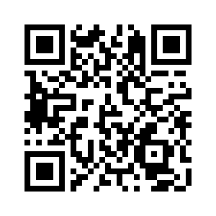
QR Scanning

Slide 6
Upcoming Features
Developing Face detection along side scanning QR code
Creating a toggle for every device(DeviceId)
Adding location details and logging them when the QR code is scanned
Show all devices on a map on the web console

Slide 7

Thank you!
Team 13

